Slide 1
Duration
C
Yes
628
F
G
No
E
No
Yes
387.5
No
D
219.5
A
B
No
No
maj jan jul jun aug nov apr feb sep mar dec oct

Slide 2
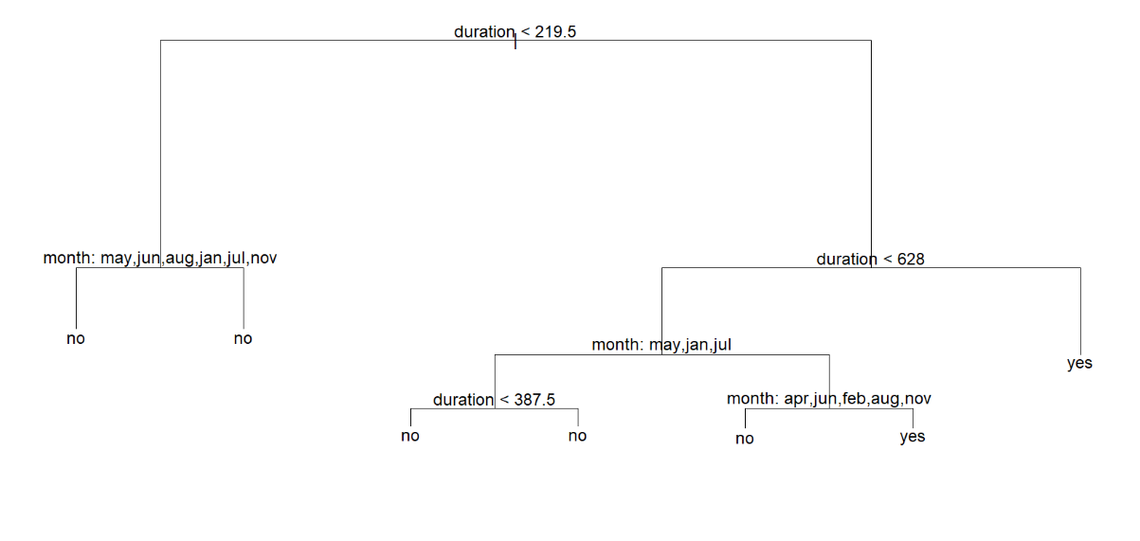
A
B
C
D
E
F
G

